Slide 1
Year 1 Parent Meeting
Monday 11th September

Slide 2
Welcome
Staffing
Mornings
Routine of our day
PE
Outdoor learning
End of the day

Slide 3
Year 1 Project overview
Autumn Term
Superheroes
Memory Box
Spring Term
Paws, claws and whiskers
Splendid Skies
Summer Term
Enchanted Wood
Moon Zoom

Slide 4
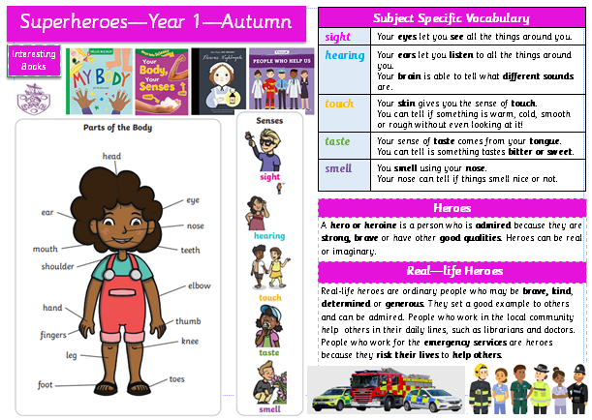
Knowledge Mats

Slide 5
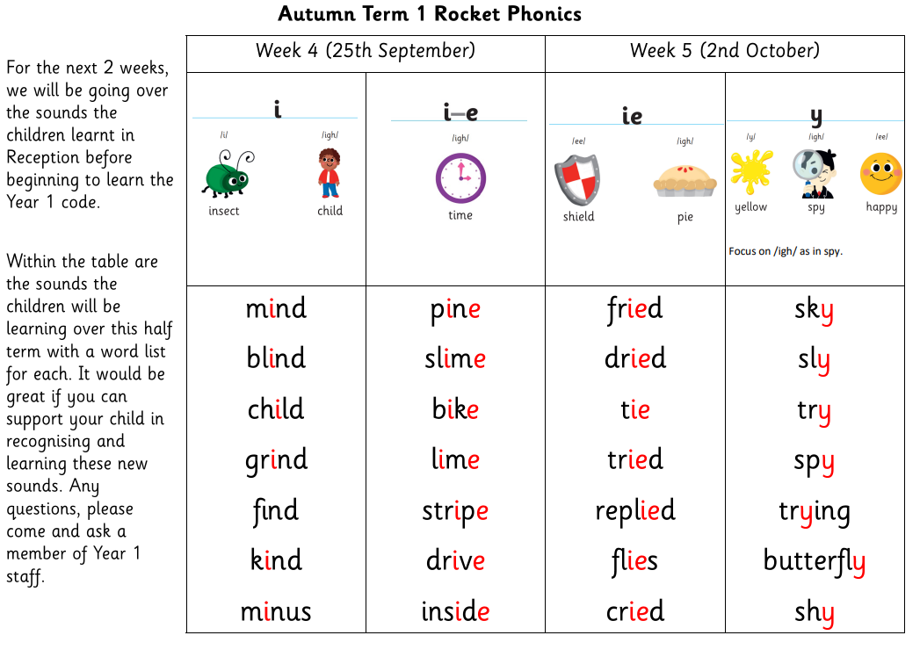
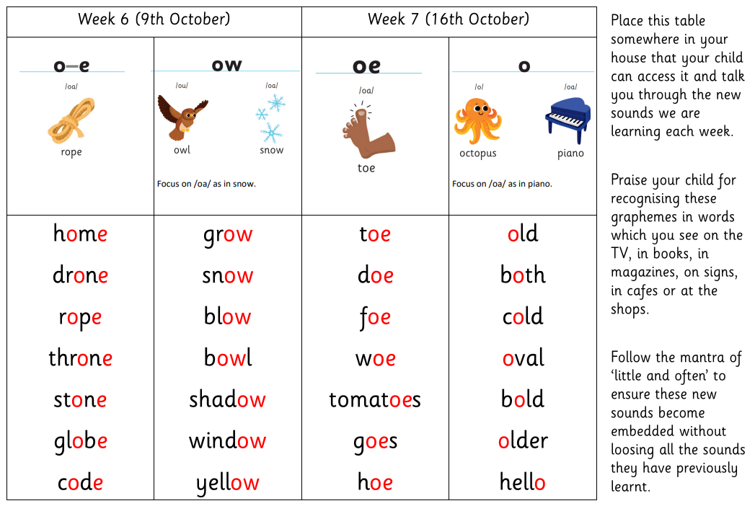
Phonics support at home

Slide 6
Reading and Homework
Reading is such a crucial life skill and is placed at the heart of our St Nicolas curriculum
Books are changed every week – 2 books
Focus on fluency, expression and confidence – fully decodable
Reading record – please record when you read – try to read 3 times a week
Books and records to be in every day as there are no set days for reading
Rocket Phonics books – online – target readers
Home challenge – out on the Friday and due back by the following Wednesday.

Slide 7
Rewards
Class dojo
Monster of the week (wigglies)
Monster of the term
Achievement assembly
House points

Slide 8
Communication
We will use ParentMail to contact you about any changes or future events.
Contact us…
On the gate – before or after school
Phone call via the school office
Via school office email

Slide 9
Parent support
Your time – parent helpers for listening to readers or sharing a game with a small group of children, offering time as part of the SNSA or helping on school trips. DBS checks – committed to a set time weekly.
Your expertise or skill – maybe you have a skill which links to one of our topics which you are willing to share.
Your passion – maybe you are happy to share this with the class. Children love to ask questions and their curiosity drives their learning!
Wish list

Slide 10
Thank you for giving up your time today! Are there any questions?

